Slide 1
Asynchronous Programming Part 2
Lecture 2

Slide 2
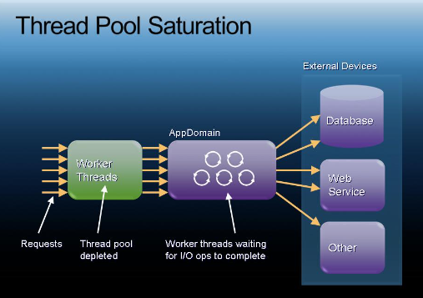
Summary of Asynchronous Programming Model
A server program will have a thread pool.
When requests are allocated a thread, they will block that thread while they are attempting to access database server.
When all threads are allocated, it will start to form a queue waiting requests.
With asynchronous programming, we can issue the I/O operation to the database thread pool instead, and we can release the current thread back to the thread pool.
When a second request comes in, it can access that thread from the thread pool.
This allows much better scalability and can satisfy many more requests.

Slide 3
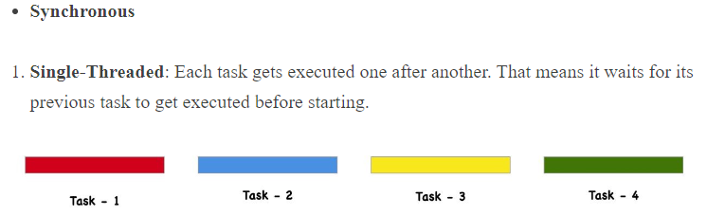
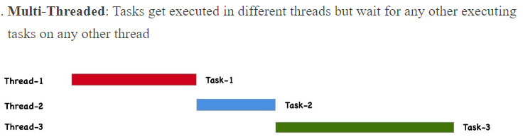
Tasks and Threads
Synchronous Programming
In the context of client requests to a web server, we are describing C# Tasks.
The Task object is typically executed asynchronously on a thread pool thread rather than synchronously on the main thread of the application.
A thread will execute one or more Tasks.
Threads can process Tasks synchronously or asynchronously.

Slide 4
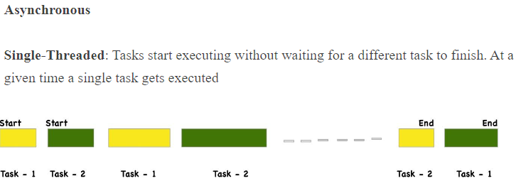
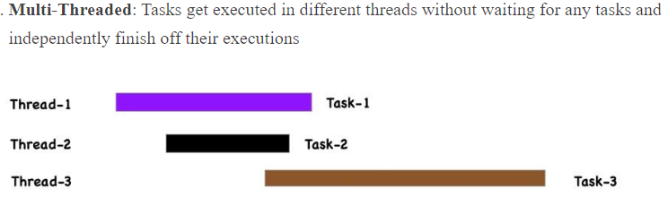
Tasks and Threads
Tasks Versus Threads
Asynchronous Programming
Threads are basic units of execution that are allocated processor time by the OS.
Threads can be managed independently by a thread scheduler which is part of the OS.
Tasks on the other hand are a higher-level abstraction, that basically represents a unit of work, that’ll be completed in future.
For example, a Task<T> is nothing but a task that comes with the promise of returning a value of type T when the task completes e.g. C# method

Slide 5
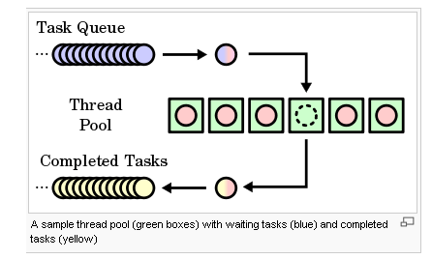
Task Objects– Core of Asynchronous Programming Model
Task is the corner stone of asynchronous programming within C#.
A task is like a request, which a thread will complete or execute.
A task object which represents a background I/O operation for example, can return a status - completed, faulted, waiting to run, executing etc.
Therefore, when an I/O request is made, the Task will have a status of waiting.

Slide 6
Two Ways to create a Task
Task.Start() - Creates a new Task and gives it the Action to run. It queues the Task to the target TaskScheduler and then it starts it.
Synchronization must take place otherwise multiple threads may try to start a task.
Task.Run(Action): Task.Run() gives the Action to run on the ThreadPool, which takes a thread from the ThreadPool and runs our code on that thread as per schedule and availability.
We will use both but better to stick with Task.Run() most of the time.

Slide 7
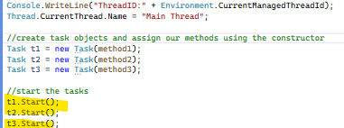
Benefits of Tasks
Tasks are more efficient and allow a more scalable use of system resources.
Behind the scenes, tasks are queued to the ThreadPool.
These algorithms provide load balancing to maximize throughput.
Tasks are relatively lightweight, and you can create many of them to enable fine-grained parallelism.
Tasks and the framework built around them provide a rich set of APIs that support waiting, cancellation, continuations, exception handling, detailed status, and custom scheduling.

Slide 8
Task Asynchronous Programming(TAP) Model
Asynchronous Model
You can avoid bottlenecks and enhance the overall responsiveness of your application by using asynchronous programming.
Access to a database resource sometimes is slow or delayed.
If this activity is blocked in a synchronous process, the entire application must wait.
In an asynchronous process, the application can continue with other work that doesn't depend on the database resource until the potentially blocking task finishes.
The core of async programming is the Task and Task<T> objects, which model asynchronous operations.
They are supported by the async and await keywords.
For I/O-bound code, you await an operation that returns a Task or Task<T> inside of an async method.
For CPU-bound code, you await an operation that is started on a background thread with the Task.Run method.

Slide 9
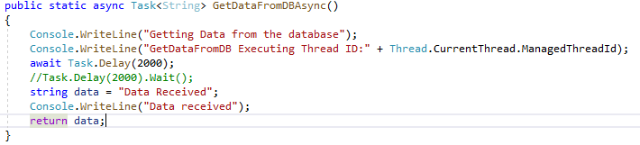
Async and Await keywords
Normally, a async method is created with the suffix async appended to the method name.
For example, an asynchronous Get operation that returns a Task<String> can be named GetAsync.
A Task object will be returned inside of the async method.
The purpose of the await keyword is that it will yield control back to the calling thread of the async method which allows an application to be responsive.
So the async method simulates a background thread, and once it is completed, the await keyword triggers the CPU to continue with the remaining lines of a method.

Slide 10
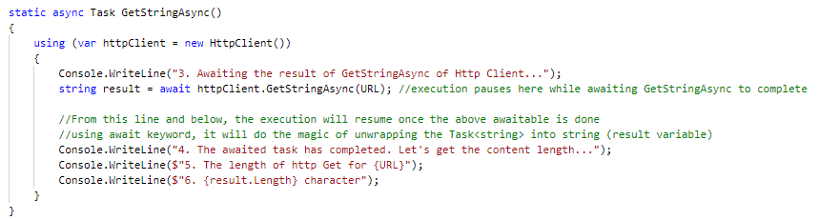
Lets examine the await approach

Slide 11
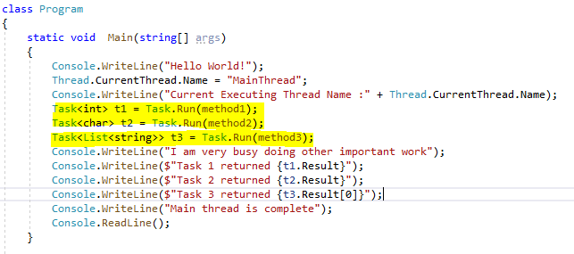
I/O Bound and CPU Bound Operations
Async code can be used for both I/O-bound and CPU-bound code.
Async code uses Task<T> which are constructs used to model work being done in the background.
If running CPU Bound operations, we must use a CPU core. If this CPU operations is time-consuming, then it may cause the application to become unresponsive.
We can call the CPU method through Task.Run() which will allow the calling Main thread to continue to interact with the end user while another thread is allocated and deals with the time-consuming CPU bound operations.

Slide 12
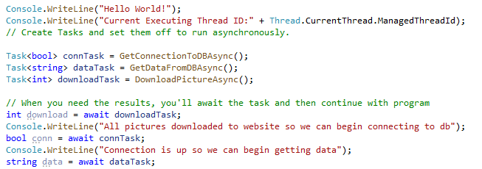
I/O Bound Operation
With an I/O bound operation, the Task.Run() approach would be useless as each Task.Run() uses a thread from the main threadpool.
This thread would be blocked while waiting on the I/O subsystems to complete, thereby, wasting a thread unnecessarily.
Better approach, is to allow the current thread to execute the I/O ops and use async code to prevent blocking of the current thread.
This means the current thread would call the async method and then continue with other operations.
When the I/O operation completes, the await() method would trigger an event with the calling thread and process the results of the I/O bound operation.

Slide 13
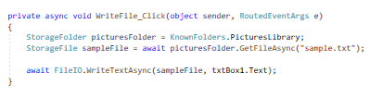
Async and Await
async methods need to have an await keyword in their body.
async void should only be used for event handlers.
async void is the only way to allow asynchronous event handlers to work because events do not have return types (thus cannot make use of Task and Task<T>.

Slide 14
Conclusion
Asynchronous programming is very important contribution to Windows 10 Apps.
Using the Task based model, these task objects can return a result. There is no direct mechanism to return the result from a thread.
All apps today must be responsive and resources must be used efficiently.
Many input/output operations are available which typically included communicating with external storage resources, web, databases, cameras, pens etc.
These must be managed effectively to give the user a rich experience.
For I/O bound jobs we should create async methods and use the await keyword.
For long running CPU bound jobs we should use Task.Run().

